Slide 1
Hate Speech detection using Transformers (Deep Learning)

Slide 2
By : Mohammad Bani Abed Alghani
University: Yarmouk University
Email: mohammedbaa321@gmail.com
Country: Jordan
Specialization: NLP
Batch Code: LISUM32
Date: 30-June-2024
Submitted to: Data Glacier

Slide 3
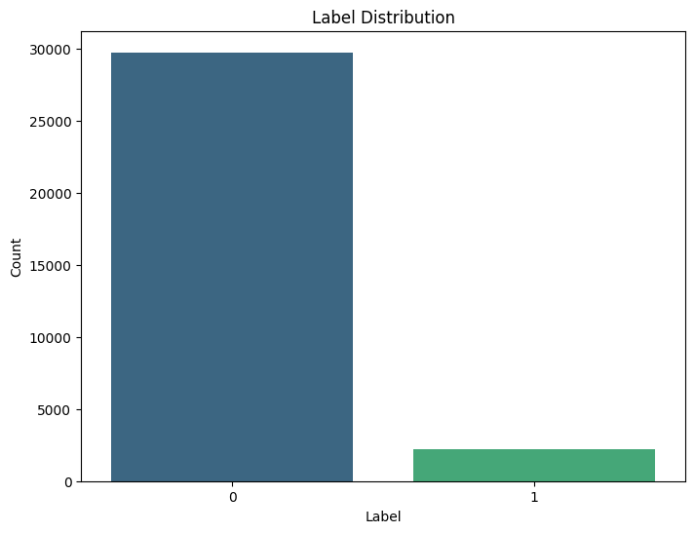
Label Distribution
The label distribution plot is a fundamental step in EDA, providing a clear picture of the dataset's composition regarding the target variable. It helps in identifying any imbalances or biases in the data, guiding the subsequent steps in the analysis or machine learning pipeline.

Slide 4
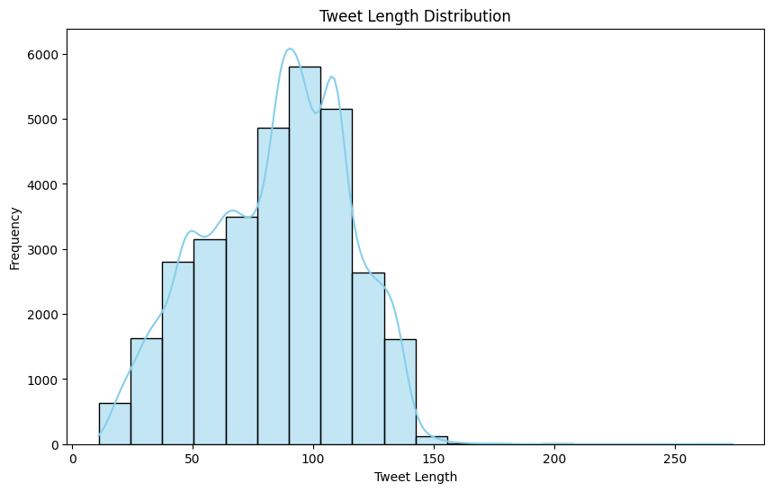
Tweet Length Distribution
Distribution Shape:The histogram shows the frequency of tweets across different tweet lengths, while the KDE curve provides a smooth estimate of the probability density function of the tweet lengths.The distribution appears to be roughly normal (bell-shaped), with a peak around the 80-100 character range.Central Tendency:The majority of tweets are concentrated between 50 and 150 characters, indicating that most users tend to write tweets that are moderate in length.Spread and Skewness:The spread of the distribution shows that tweet lengths vary, with some tweets being as short as 0-50 characters and some extending to over 200 characters.There is a slight right skew, as the tail on the right side (longer tweets) extends further than the left side (shorter tweets).Outliers:There are few tweets with lengths greater than 150 characters, suggesting that while it's possible to write longer tweets, it's not very common.Data Quality:Understanding the distribution of tweet lengths can help in preprocessing steps for text analysis. For instance, excessively short or long tweets might need special handling.This information can also be useful for model input, where normalization or truncation/padding might be applied to ensure uniform tweet lengths.Modeling Implications:For natural language processing (NLP) tasks, knowing the typical tweet length can help in designing appropriate features and selecting model architectures. For example, LSTM and Transformer models can be tailored for the typical sequence length observed.

Slide 5
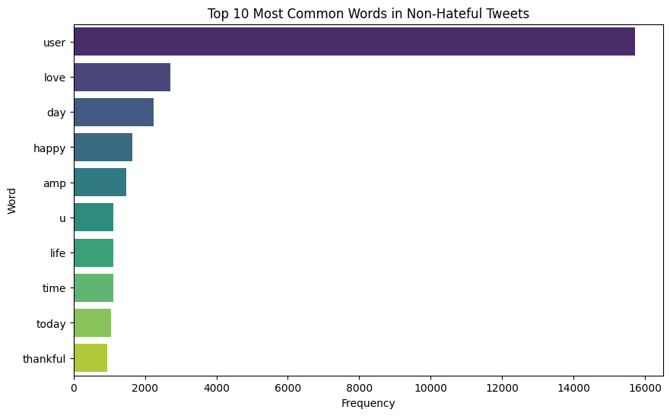
Most Common Words in Non-Hateful Tweets
The bar plot of the top 10 most common words in non-hateful tweets provides insights into the nature of these tweets. It highlights common themes of positivity and daily life. The analysis also underscores the importance of thorough text preprocessing to ensure that placeholders and HTML entities do not skew the understanding of tweet content. This information is useful for understanding the dataset's context and for guiding further text analysis and model development.

Slide 6
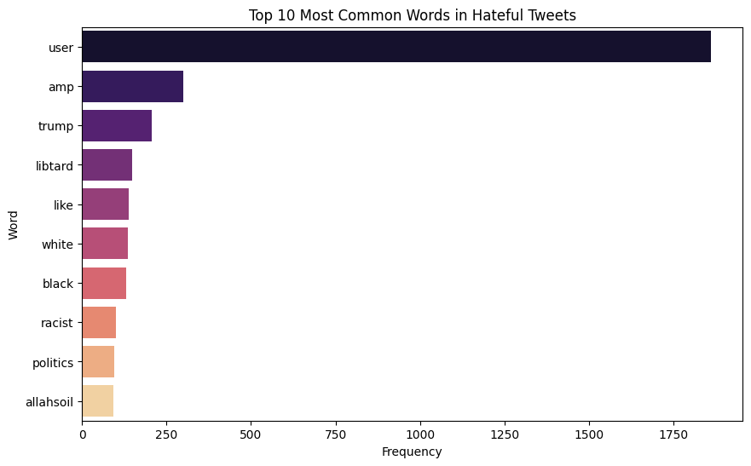
Most Common Words in Hateful Tweets
The bar plot of the top 10 most common words in hateful tweets provides insights into the nature of these tweets. It highlights common themes such as political discourse and racial issues, which are prevalent in hateful tweets. The analysis also underscores the importance of thorough text preprocessing to ensure that placeholders and HTML entities do not skew the understanding of tweet content. This information is useful for understanding the dataset's context and for guiding further text analysis and model development, especially for detecting and mitigating hate speech.

Slide 7
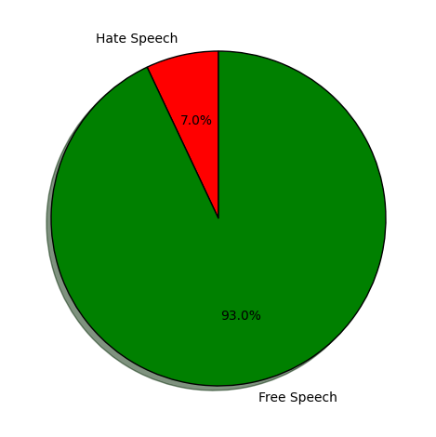
Distribution of Hate Speech vs. Free Speech Analysis
The pie chart effectively visualizes the distribution of hate speech versus free speech in the dataset. It highlights a significant imbalance, with the majority of tweets being non-hateful. This insight is crucial for understanding the context of the dataset, guiding the development of machine learning models, and informing the strategies for handling data imbalance.

Slide 8
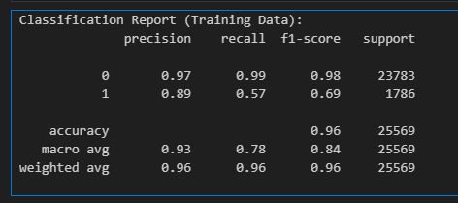
Result Of LSTM Algo (Train)

Slide 9
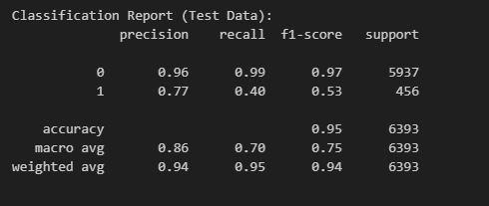
Result Of LSTM Algo (Test)

